Slide 1

Cortex
An ad-hoc centralized communications server
Anas Ambri
Nick Sweet

Slide 2
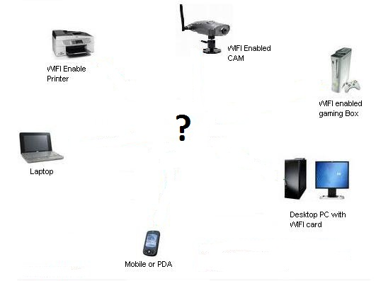
Problem statement
Question:
  What’s the best way to securely transfer data between people and/or devices?
Answer:
  Keep it local! No need for the internet.

Slide 3
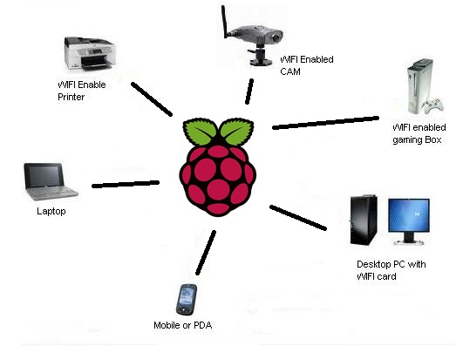
Required Hardware
1 x Raspberry Pi
1 x USB WiFi Adapter
n x Internet Connected Devices:
  Laptops, Mobile Phones, etc.

Slide 4
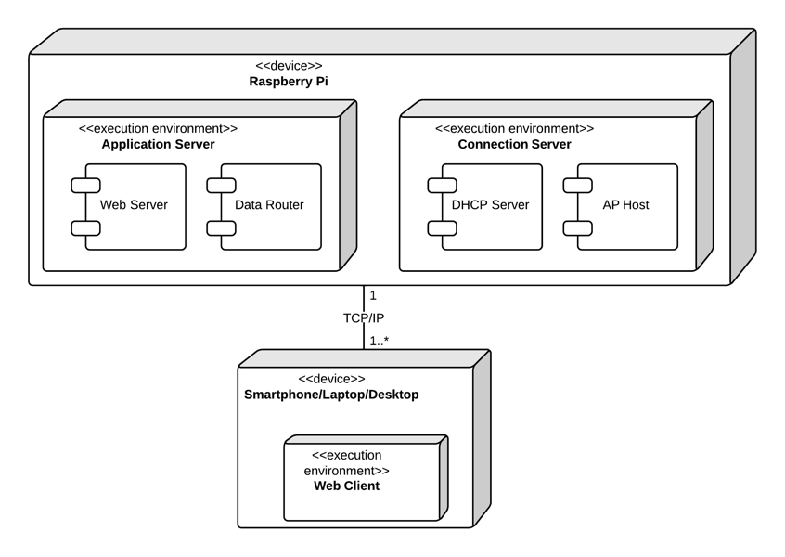
Required Software

Slide 5
Connection Server: hostapd and dhcp
Host Access Point Daemon: hostapd
  Define static IP for wlan0
  Broadcast cortex ssid (psk: cortex10)
DHCP server: isc-dhcp-server
  Provides dynamic IP addresses for incoming connections
Bonus: NAT configuration for multiple connections and
IP forwarding through eth0 as well!

Slide 6
Application Server Requirements
Low latency
Bi-directional communication between:
  Server to client
  Client to server
  Client to client
Ability to simulate chat rooms

Slide 7
Using Bayeux Protocol
Bayeux protocol developed by the Dojo Foundation
Meets all our requirements, but requires integration work
Big plus:
  Provides with concept of channel, which are URIs that describe a single “chat room”
  Uses JSON, e.g., a message can be anything

Slide 8
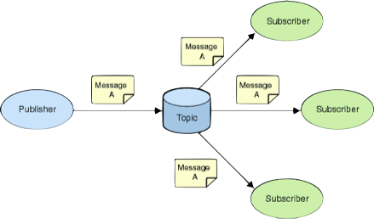
Subscriber-Publisher pattern
Any client can subscribe or publish to a channel
Client-client communication happens through server

Slide 9
Thanks for listening!
Time for the demo!
Please connect to the ‘cortex’ ssid on your phone or laptop and enter the password ‘cortex10’.
Then connect to cortex.local:3000 (or 198.162.42.1:3000 from a machine without mDNS) and start chatting!

